Slide 1
Calculation Logic
2025.05.29

Slide 2

Question?
You are planning to sell Macarons. You would like to match the Lowest Price that is available in the Market. How do you calculate and compare?

Slide 3

How Do You Know Which One is Cheaper?
1. A or B?
Macaron A = SGD 12.75 subject to 12% GST, 5% Service Charge, SGD 2 Take Out Box
Macaron B = SGD 17.00 Total
2. A or C?
Macaron A = SGD 12.75 subject to VAT, Service Charge, Platform Fee
Macaron C = SGD 12.75 subject to GST, Service Charge, Take Out Box

Slide 4
Terminologies
Customer’s Request = Marketing/Pricer-Defined Rate Structure based on their interpretation of Customer’s T&C; Executed Using Set Surcharge and Update Condition
LT MRG = Long Term Minimum Rate Guideline; Minimum Rate Level Set by Trade Management to Offer for Long Term Customers
Target CM = Target Contribution Margin; Minimum CM Level Set by Trade Management where Rate Offer To Long Term Customers Should be Based On.
Current Contract = Agreed Rate Levels between Customer and ONE for Specified Port Pairs
Benchmark Rates = Baseline/Basis of Marketing/Pricing Offer; Can be based on LT MRG, Target CM, Current Contract.
Reference Base (Benchmark Rate Structure) = Surcharge Condition of Benchmark Rates
All In Calculation = Benchmark Rates + Benchmark Rate Structure (Subject)
Base Rate = Rate Level Marketing/Pricing intends to offer/export to customer/customer sheet; It is calculated using All In Rates (Minus) Customer’s Request Rate Structure

Slide 5
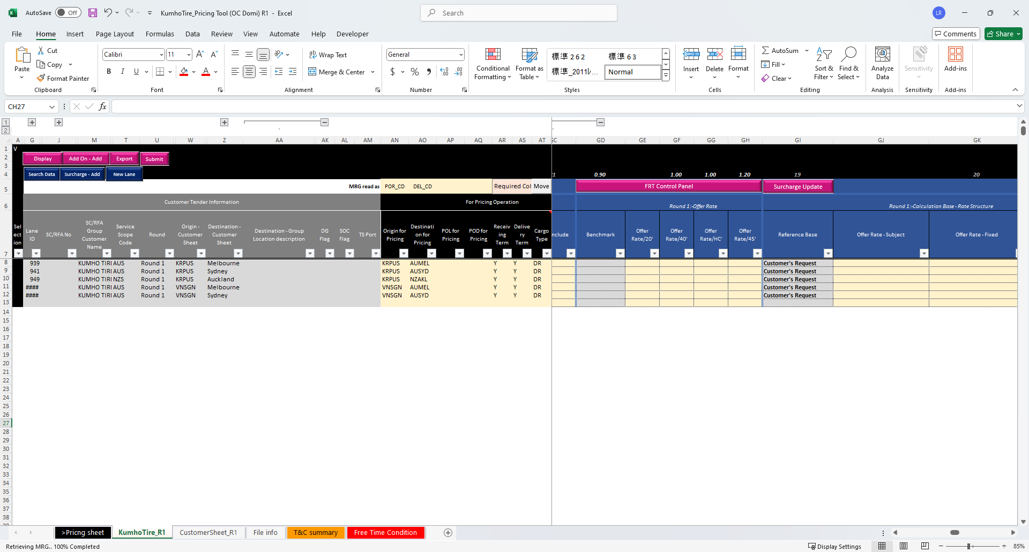
Glossary
A
B

Slide 6
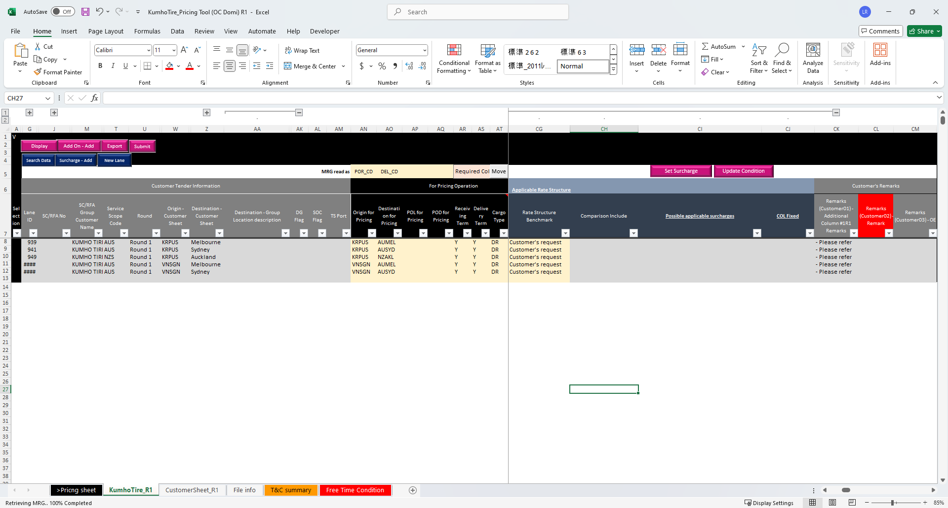
Glossary
C

Slide 7
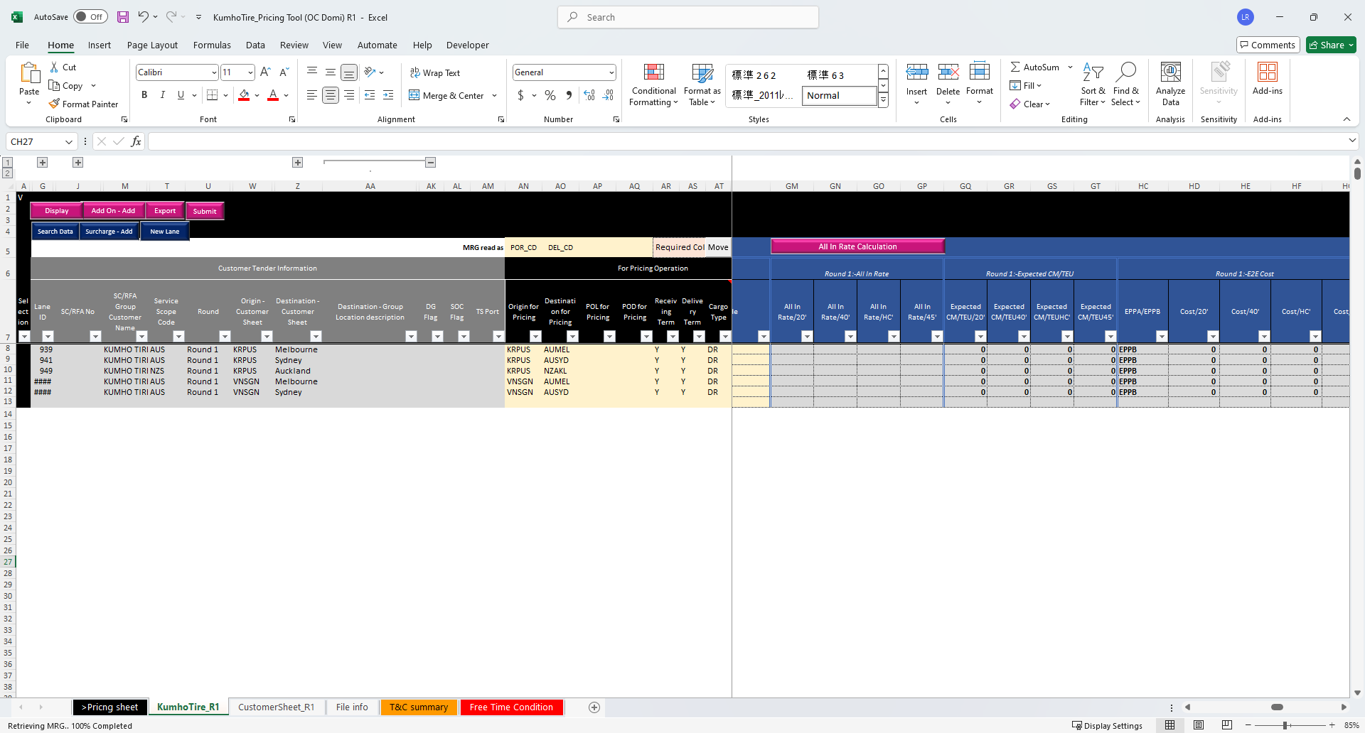
Glossary
D = A + B

Slide 8
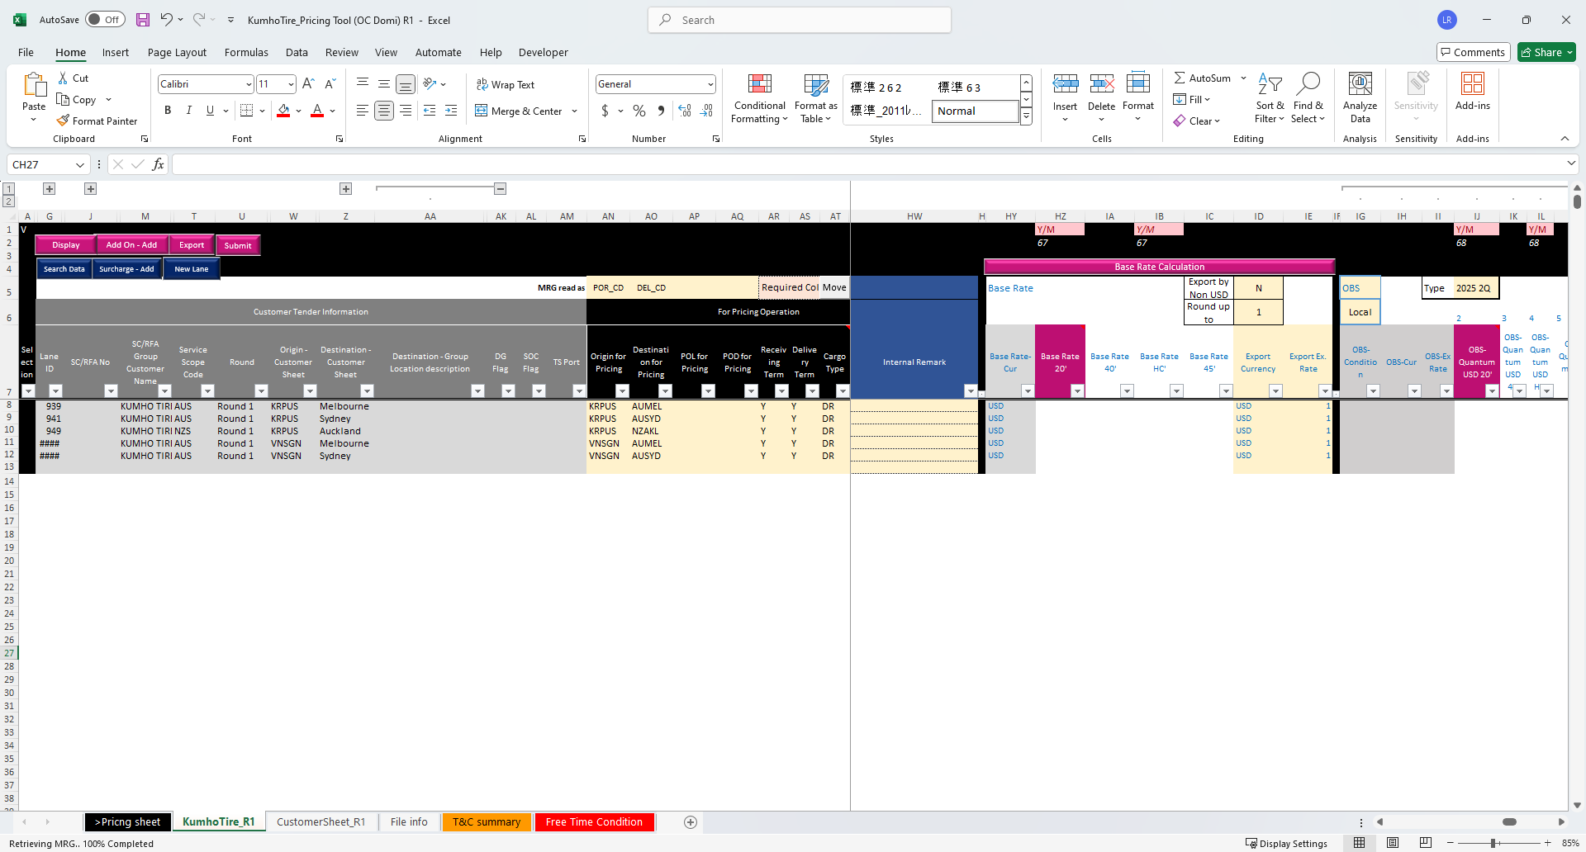
Glossary
E = D - C

